Slide 1
Microprocessor System Design
Omid Fatemi
Machine Language Programming
(omid@fatemi.net)

Slide 2
Class Work #2
8088

Slide 3
First Part – Closed-Book

Slide 4
Questions
If both 8086 and 8088 have 16-bit ALU and registers, what is the difference between them?
In 80286 (24 bit address, 16 bit data), how is the memory organized?
What is the meaning of byte addressablity in 80x86?
What are AD0-AD7 pins?
Explain the sequence of read operation from a typical memory.
In such sequence what would be the status of /RD (active low) in CPU?
Notes:
Explain the sequence of write operation to a typical memory. (bonus question)
Why there are 2 Gnd pins on 8088? (2 reasons)
What is Von Neumann Architecture
What is ALE pin?
If both 80286 and 80386SX have 16-bit external data bus, what is the difference between them?
In 80386 (32 bit address, 32 bit data), how is the memory organized?

Slide 5
Second Part – Open-Note

Slide 6
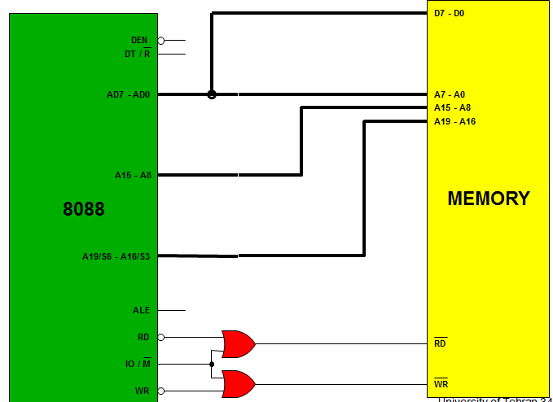
Problems
Draw a typical memory, size:
32M-bit and 4-bit data bus.
128Mbit and 8-bit data bus.
What is the physical address of the first instruction which is fetched after reset? (explain)
Explain in detail (by timing diagram) what does CPU do during execution of this? (BX = 9E52, DS = 8000) MOV AL, [BX]
What is the problem with this design? Explain using the previous operation.
Notes:
Design the Power-On-Reset circuit for 8088 and also design a reset button.

Slide 7
Processor Timing Diagram of 8088 (Minimum Mode) for Memory or I/O Read
T1
T2
T3
T4
CLOCK
__
DT/R
ALE
AD7 - AD0
A7 - A0
D7 - D0 (from memory)
A15 - A8
A15 - A8
A19/S6 - A16/S3
A19 - A16
S6 - S3
__
IO/M
if I/O ACCESS this is HIGH, if MEMORY ACCESS this is LOW
____
RD
______
DEN

